Slide 1
Session 3.1: Project Leadership and Team Management Skills
Dr Andre Samuel
andre.samuel@sam.edu.tt

Slide 2
Learning Outcomes

Slide 3
Recap Session 2

Slide 4
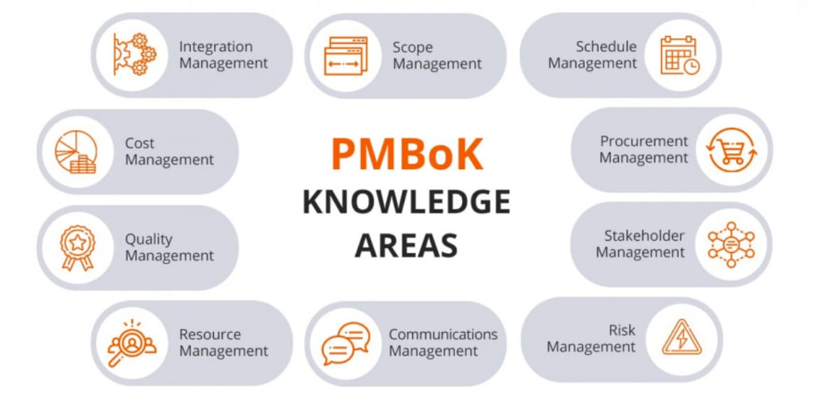
Ten Knowledge Areas PMI (2013, pg. 7)

Slide 5
Project Management Processes by Process Groups
Initiating
Planning
Executing
Monitoring and Controlling
Project Close
Why/what is the project
Project charter
Objectives
Team structure
Risks
Stakeholders
Scope
Budget/Costs
Work Breakdown Structure
Gantt chart
Communication plan
Risk management
Direct/manage
Quality management
Team management
Communications
Stakeholders
Status/tracking
Project control
Scope, Cost, Schedule Quality and Resources Control
Risk monitoring
Lessons learnt
Reporting

Slide 6
PM Interpersonal Skills PMI (2021)
Leadership
Team building
Motivation
Communication
Influencing
Decision making
Political and cultural awareness
Negotiation
Trust building
Conflict management
Coaching

Slide 7
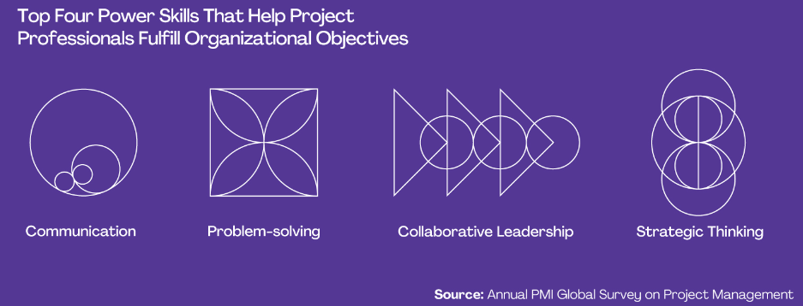
What Are Power Skills?
PMI (2022) defines power skills as abilities and behaviors that facilitate working with others and help project professionals to succeed in the workplace.
Some individuals and other organizations also refer to them as “soft skills” or “interpersonal skills.”
PMI 2022

Slide 8
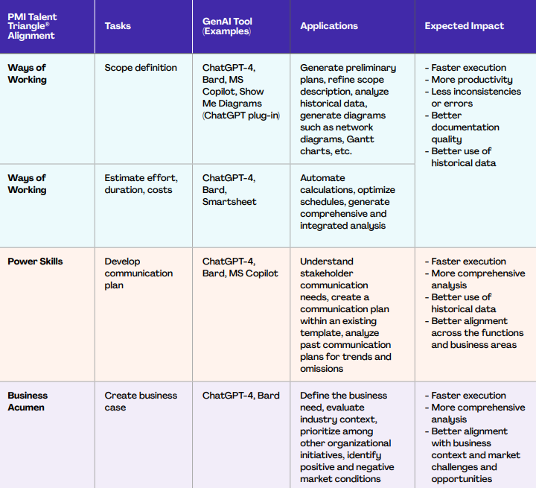
AI Skills and Tools for Project Managers
PMI Talent Triangle
PMI (2023) Shaping the Future of Project Management With AI

Slide 9
For Part 1.b- Reflection before and after module
You can adapt and use the template
Copy and Paste into Word Document
Project Management Skills | Did you have this skill (before the module)? Yes No | If YES score 1 - 5 (with 1 being less skilled and 5 being most skilled) How can you evidence this skill? | Did you improve in this skill by the end of the module? | End of module score 1 - 5 (with 1 being less skilled and 5 being most skilled)

Slide 10
Project Governance and Leadership

Slide 11
What is Project Governance?
Project governance framework provides the project manager and team with structure
As such, there needs to be an overall framework for:
making project decisions;
defines roles, responsibilities,
accountabilities for the success of the project
(PMI 2021)
Therefore, the organization’s structure must support the project

Slide 12
Project Governance and Internal Project Team (adapted from Maylor, 2017, pp. 62)
PROGRAMME MANAGEMENT
 | PROJECT BOARD/PROJECT STEERING GROUP
USER REPRESENTATIVE | PROJECT SPONSOR | SUPPLIER REPRESENTATIVE
Senior User | Executive/Senior responsible Owner | Senior Supplier
TECHNICAL ADVISORY GROUP
CHANGE BOARD Delegated authority Technical capability
PROJECT MANAGER
PROJECT MANAGEMENT OFFICE Admin support Technical support Configuration management
TEAM MANAGER
TEAM MANAGER
TEAM MEMBERS
TEAM MEMBERS
Notes:
As a Project Manager you are working within the organisational structure. You will need to work with the governance in place, e.g. the Project Board/Steering Group and also need to lead your project team

Slide 13
Integration of Governance using a Matrix Structure
Lock (2007)

Slide 14
Project Leadership
Leadership
According to PMI (2021, pp 23-29), project leadership involves 4 main aspects:
Establishing and maintaining vision
Critical thinking
Motivating team members
Interpersonal skills
The project team is so integral to project success…
Notes:
Establishing and maintaining vision
People need to understand the purpose to commit their time and energy to the project. Project leaders need a project vision that summarizes the project's purpose clearly and succinctly.
Critical thinking Leaders need to use logical, rational evidence-based thinking to be able to understand any problems or issues that arise during the project
Motivating team members understand what motivates team members and working with them so they remain committed to the project and its outcomes
Interpersonal skills
In projects, these are focused on emotional intelligence (understanding our own and others' emotions), decision-making and conflict resolution.

Slide 15
Situational Leadership for Project Managers
Leaders need to adapt their style and approach to the needs of the team and the work that needs to be accomplished
Adapt style in terms of:
Task Behaviour- Directive
Relationship Behaviour- Supportative
Also need to consider Team Member’s Performance Readiness:
Willingness
Competence, Ability and Development
Commitment

Slide 16
Situational Leadership Model
Telling- As the Project Manager, you will need to provide clear directions and supervision. Making sure roles and responsibilities are clearly defined as well as explicitly telling your followers what, how, when and where to perform specific tasks
Selling- As the Project Manager, you will need to provide direction since their ability is low. Additionally, you will want to reinforce their willingness and enthusiasm by providing supportive behavior. For example, explaining why the task is important and needs to be done.

Slide 17
Participating- As the Project Manager, your supportive behavior should be high. Facilitating actions such as active listening and sharing in decision-making should be emphasized
Delegating- As the Project Manager, little direction or support is needed. Followers are very self-directed at this level and are able to make their own decisions. Because of their high level of motivation, they also do not need a lot of supportive behavior.

Slide 18
Group Activity- Appropriate Leadership Style
Scenario
2 team members leave in week 4 of your project during the execution stage, citing stress as the cause.
As a result new team members joined in week 5 of the project
In Your Group
Discuss- What would be the LS before they left and now with the new team?
Post in Chat:
Before- LS
Now- LS

Slide 19
BREAK
Take a 10 minute break, after the break…

Slide 20
Team Development

Slide 21
Project teams need to feel like a team to be effective…
Team &
Organisation
Group
2 or more people who are connected by or within social relationships
Interdependency and shared values
Team
2 or more people with common goal(s) and shared responsibility
psychological contract

Slide 22
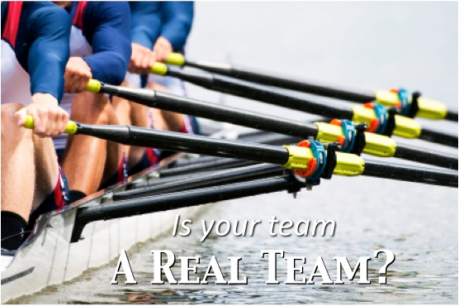
Real team or pseudo team?
Call themselves or are called by others a team
Different objectives
Typical tasks require team members to work alone or in separate dyads towards disparate goals
West and Lyubovnikova, 2012
Notes:
work, not agreed on team objectives.

Slide 23
Stages of Team development
Tuckman (1965) says that teams go through 4 phases: forming; storming; norming and performing. He added adjourning later in 1975.
It is important to be aware of these phases in your project and manage them effectively – project progress depends on it
3
2
Norming
Storming
4
1
Performing
Forming

Slide 25
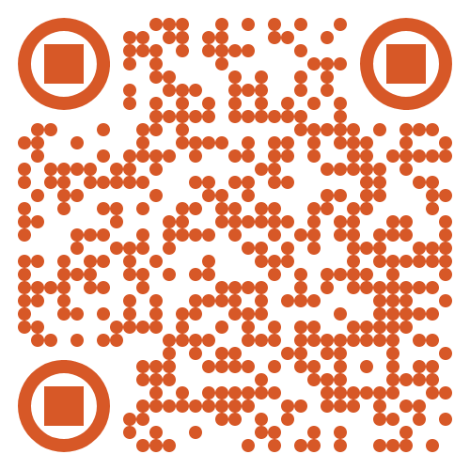
Activity: Team development and LS
How may your leadership style vary/adapt during these stages?
Decide on the appropriate leadership style for each team development stage
Post on Padlet

Slide 26
The magic of teams… “It’s about finding the magic mix, that blend of skills and experience that combines maturity, energy, determination and creativity. It’s like a ballet when it happens. Beautiful to behold!” (West, 2012, pp. 42)

Slide 27
Jobs and roles are important…
People in the project team need to be matched to jobs…
Eligibility/entry criteria | Suitability/performance criteria
Skills | Behavioural tendencies
Qualifications | Temperament
Experience | Aptitude

Slide 28
Team Roles

Slide 29
Belbin’s 9 Team Roles
'Team Role' refers to one of nine clusters of behavioural attributes, identified by Dr Meredith Belbin’s (1993) research.
"The types of behaviour in which people engage are infinite. But the range of useful behaviours, which make an effective contribution to team performance, is finite.
These behaviours could be grouped into a set number of related clusters to which the term ‘Team Role’ is applied.“ (Belbin, 1993)
The research indicated that the most successful teams were made up of a diverse mix of behaviours.
Each team needs access to each of the nine Belbin Team Role behaviours to become a high-performing team.
3 categories: task, thinking and social

Slide 30
Task- or action-oriented roles Belbin’s (1993) model
Shaper
Provides the necessary drive to ensure that the team keeps moving and does not lose focus or momentum.
Strengths: Challenging, dynamic, thrives on pressure. Has the drive and courage to overcome obstacles.
Allowable weaknesses: Can be prone to provocation, and may sometimes offend people's feelings.
Don't be surprised to find that: They could risk becoming aggressive and bad-humoured in their attempts to get things done.
Implementer
Needed to plan a workable strategy and carry it out as efficiently as possible.
Strengths: Practical, reliable, efficient. Turns ideas into actions and organises work that needs to be done.
Allowable weaknesses: Can be a bit inflexible and slow to respond to new possibilities.
Don't be surprised to find that: They might be slow to relinquish their plans in favour of positive changes.
Completer-Finisher
Most effectively used at the end of tasks to polish and scrutinise the work for errors, subjecting it to the highest standards of quality control.
Strengths: Painstaking, conscientious, anxious. Searches out errors. Polishes and perfects.
Allowable weaknesses: Can be inclined to worry unduly, and reluctant to delegate.
Don't be surprised to find that: They could be accused of taking their perfectionism to extremes.
Notes:
Shaper
The shaper is a task-focused leader who abounds in nervous energy, who has a high motivation to achieve and for whom winning is the name of the game. The shaper is committed to achieving ends and will ‘shape’ others into achieving the aims of the team. He or she will challenge, argue or disagree and will display aggression in the pursuit of goal achievement. Two or three shapers in a group, according to Belbin, can lead to conflict, aggravation and in-fighting.
Implementer
The Implementer takes what the other roles have suggested or asked, and turns their ideas into positive action. They are efficient and self-disciplined, and can always be relied on to deliver on time. They are motivated by their loyalty to the team or company, which means that they will often take on jobs everyone else avoids or dislikes. However, they may be seen as closed-minded and inflexible since they will often have difficulty deviating from their own well-thought-out plans.
Completer Finisher
The Completer Finisher is a perfectionist and will often go the extra mile to make sure everything is "just right," and the things he or she delivers can be trusted to have been double-checked and then checked again. The Completer Finisher has a strong inward sense of the need for accuracy, rarely needing any encouragement from others because that individual's own high standards are what he or she tries to live up to. They may frustrate their teammates by worrying excessively about minor details and refusing to delegate tasks that they do not trust anyone else to perform.

Slide 31
Individual- or thinking-related roles Belbin’s (1993) model
Plant
Tends to be highly creative and good at solving problems in unconventional ways.
Strengths: Creative, imaginative, free-thinking, generates ideas and solves difficult problems.
Allowable weaknesses: Might ignore incidentals, and may be too preoccupied to communicate effectively.
Don't be surprised to find that: They could be absent-minded or forgetful.
Monitor-evaluator
Provides a logical eye, making impartial judgements where required and weighs up the team's options in a dispassionate way.
Strengths: Sober, strategic and discerning. Sees all options and judges accurately.
Allowable weaknesses: Sometimes lacks the drive and ability to inspire others and can be overly critical.
Don't be surprised to find that: They could be slow to come to decisions.
Specialist
Brings in-depth knowledge of a key area to the team.
Strengths: Single-minded, self-starting and dedicated. They provide specialist knowledge and skills.
Allowable weaknesses: Tends to contribute on a narrow front and can dwell on the technicalities.
Don't be surprised to find that: They overload you with information.
Notes:
Plant
Plants are creative, unorthodox and a generator of ideas. If an innovative solution to a problem is needed, a Plant is a good person to ask. A good plant will be bright and free-thinking. Plants can tend to ignore incidentals and refrain from getting bogged down in detail. The Plant bears a strong resemblance to the popular caricature of the absentminded professor-inventor, and often has a hard time communicating ideas to others.
Monitor Evaluator
Monitor Evaluators are fair and logical observers and judges of what is going on. Because they are good at detaching themselves from bias, they are often the ones to see all available options with the greatest clarity. They take everything into account, and by moving slowly and analytically, will almost always come to the right decision. However, they can become excessively cynical, damping enthusiasm for anything without logical grounds, and they have a hard time inspiring themselves or others to be passionate about their work.
Specialist
Specialists are passionate about learning in their own particular field. As a result, they will have the greatest depth of knowledge, and enjoy imparting it to others. They are constantly improving their wisdom. If there is anything they do not know the answer to, they will happily go and find it. Specialists bring a high level of concentration, ability, and skill in their discipline to the team, but can only contribute on that narrow front and will tend to be uninterested in anything which lies outside its narrow confines.

Slide 32
Team- or social-related roles Belbin’s (1993) model
Resource Investigator
Uses their inquisitive nature to find ideas to bring back to the team.
Strengths: Outgoing, enthusiastic. Explores opportunities and develops contacts.
Allowable weaknesses: Might be over-optimistic, and can lose interest once the initial enthusiasm has passed.
Don't be surprised to find that: They might forget to follow up on a lead.
Team worker
Helps the team to gel, using their versatility to identify the work required and complete it on behalf of the team.
Strengths: Co-operative, perceptive and diplomatic. Listens and averts friction.
Allowable weaknesses: Can be indecisive in crunch situations and tends to avoid confrontation.
Don't be surprised to find that: They might be hesitant to make unpopular decisions.
Co-ordinator
Needed to focus on the team's objectives, draw out team members and delegate work appropriately.
Strengths: Mature, confident, identifies talent. Clarifies goals.
Allowable weaknesses: Can be seen as manipulative and might offload their own share of the work.
Don't be surprised to find that: They might over-delegate, leaving themselves little work to do.
Notes:
Resource Investigator
The Resource Investigator gives a team a rush of enthusiasm at the start of the project by vigorously pursuing contacts and opportunities. He or she is focused outside the team, and has a finger firmly on the pulse of the outside world. Where a Plant creates new ideas, a Resource Investigator will quite happily steal them from other companies or people. A good Resource Investigator is a maker of possibilities and an excellent networker, but has a tendency to lose momentum towards the end of a project and to forget small details.
Teamworker
A Teamworker is the greasy oil between the cogs that keeps the machine that is the team running. They are good listeners and diplomats, talented at smoothing over conflicts and helping parties understand each other without becoming confrontational. The beneficial effect of a Teamworker is often not noticed until they are absent, when the team begins to argue, and small but important things cease to happen. Because of an unwillingness to take sides, a Teamworker may not be able to take decisive action when it is needed.
Coordinator
A Coordinator often becomes the default chairperson of a team, stepping back to see the big picture. Coordinators are confident, stable and mature and because they recognise abilities in others, they are very good at delegating tasks to the right person for the job. The Coordinator clarifies decisions, helping everyone else focus on their tasks. Coordinators are sometimes perceived to be manipulative, and will tend to delegate all work, leaving nothing but the delegating for them to do.

Slide 33
Activity- Which are your preferred team roles?
Take the Belbin Inventory for assessing team roles
Download from:
Canvas- Week 2
Chat
SAM VLE- PMI Module
Post your Preferred role on the chat

Slide 34
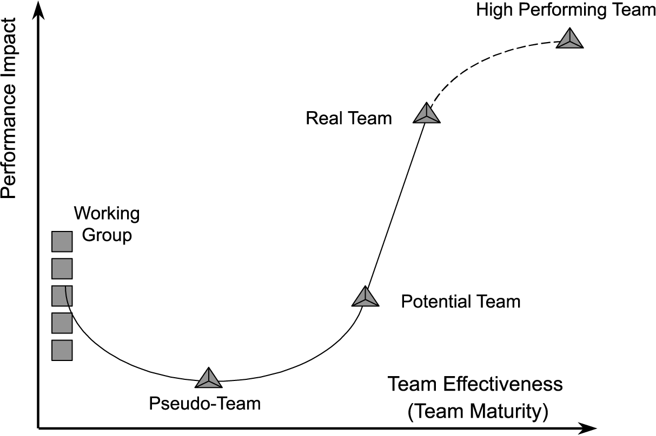
Team Performance Curve
Teams aren’t effective over-night – their performance increases as they become more mature (c.f. Tuckman’s (1965) ideas)….
(Katzenbach and Smith, 1993, pp. 84)

Slide 35
Performance is influenced by….?
K - Knowledge
S - Skills
A – Attitude
(Stevens and Campion, 1994, 1999 cited in West, 2012: 49)

Slide 36
Performance Aspects to watch out for in your Project Team
Group Think (Janis, 1982)
How to Manage it:
Create a safer environment,
Encourage debate,
Nominate a person to play “Devil’s advocate”,
Consider if you are contributing to Group Think as the leader.
Social loafing: “Many hands make light the work” (Lataně et al, 1979). Ringelmann effect – More team members, group becomes less productive
How to Manage it:
Making individual contributions to a group identifiable when possible
Minimise free riding
Set appropriate and challenging goals
Team Dysfunctions…

Slide 37
Managing the 5 Team Dysfunctions (Lencioni, 2002)

Slide 38
 Discussion: How do we manage..
Lack of Trust?
Fear of Conflict?
Lack of Commitment?
Avoidance of Accountability?
Inattention to Results?

Slide 39
Self-managed Study
Read Chapters 2 and 3 of Maylor
Have a go at the practice quiz
Complete the Belbin questionnaire (available on Canvas)
Start your 011 Individual Assignment
Part 1 - Reflection on Your Project Management Knowledge and Skills (15%)

Slide 40
BREAK
Take a 10 minute break, after the break…

Slide 41
011 Individual Assignment
Available on:
Canvas: 011 Assessment Details
SAM Vle

Slide 42
Part 1 Reflection on Your Project Management Knowledge and Skills (15%)
Approx. 500 words, not including any tables [learning outcomes: LO1; LO2; LO4]
a) Knowledge and Skills needed to be a successful project manager (complete within the first 3 weeks of the module) Discuss the different knowledge and skills, this should include both the soft skills (e.g. team work, management leadership, communication, etc.) organisational skills and technical skills (e.g. use of software and AI) required to manage projects, using appropriate reference to support your discussion. Consider the various skills discussed in the first 2-3 weeks of the module to develop a table of required knowledge and skills.

Slide 43
Reflection of your knowledge, skills and competencies at the beginning of the module (complete within the first 3 weeks of the module) and at the end of the module
At the beginning: Critically analyse your current abilities (at the beginning of the module) , in relation to the knowledge and skills identified in the part 1a and the results of your Belbin team roles questionnaire. Underpin the analysis with reflection(s) on previous project experience.
At the end of the module: Conclude this part reflecting on what you have learnt in terms of knowledge and skills. Reflect on the feedback from your Study Buddies team and any other team work you have taken part in outside of the module. [Optional] You may consider providing a visual representation of your analysis. For example, by providing a scorecard/bar chart outlining your evaluation of your ability at the beginning and end of the module.

Slide 44
For Part 1.b- Reflection before and after module
You can adapt and use the template
Copy and Paste into Word Document
Project Management Skills | Did you have this skill (before the module)? Yes No | If YES score 1 - 5 (with 1 being less skilled and 5 being most skilled) How can you evidence this skill? | Did you improve in this skill by the end of the module? | End of module score 1 - 5 (with 1 being less skilled and 5 being most skilled)

Slide 45
Self-managed Study
Read Chapters 2 and 3 of Maylor
Have a go at the practice quiz
Start your 011 Individual Assignment
Part 1 - Reflection on Your Project Management Knowledge and Skills (15%)

Slide 46
References
Belbin, R.M. 1993. Team roles at work. Oxford: Butterworth-Heinemann
Finn, J.D., Pannozzo, G.M., and Achiles, C.M. 2003., The ‘why’s’ of class size: student behaviour in small classes. Review of Educational Research, 73(3): ,321-368
Janis, Irving (1982). Groupthink. Houghton Mifflin Company.
Katzenbach, J. R., & Smith, D. K. (1993). The wisdom of teams: Creating the high-performance organization. Boston, Mass: Harvard Business School Press.
Lencioni, P. 2002, The Five Dysfunctions of a Team, Jossey-Bass
Lock, D. (2007) Project Management, 9th edition, Gower, England
Project Management Institute, 2021. A Guide to the Project Management Body of Knowledge, PMBOK Guide 6th ed. Newton Square, Pennsylvania: Project Management Institute Inc.
Tuckman, B.W. 1965. Developmental sequences in small groups. Psychological Bulletin, pp. 384-399.. The article was reprinted in Group Facilitation: A Research and Applications Journal ‑ Number 3, Spring 2001 and is available as a Word document: http://dennislearningcenter.osu.edu/references/GROUP%20DEV%20ARTICLE.doc.
West, M.A., 2012. Effective Teamwork (3rd Edition). London: Blackwell.
West, M.A., and Lyubovnikova, J., 2012., Real teams or pseudo teams? The changing landscape needs a better map. Industrial and Organizational Psychology. 5: 25-55.

